Slide 1
ChatGPT and the End of AI
COMP 4230
David J Stucki
Fall 2024

Slide 2

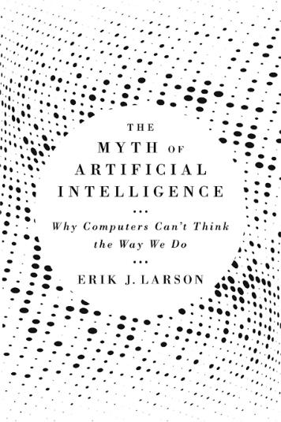
John Horgan interviews Eric Larson

Slide 3
